Slide 1

TEAM VIGILANTES CAR RENTAL APPLICATION
Team members-
Asha Aher
Jumana Nadir
Swati Narkhede
Vijaylaxmi Nagurkar

Slide 2
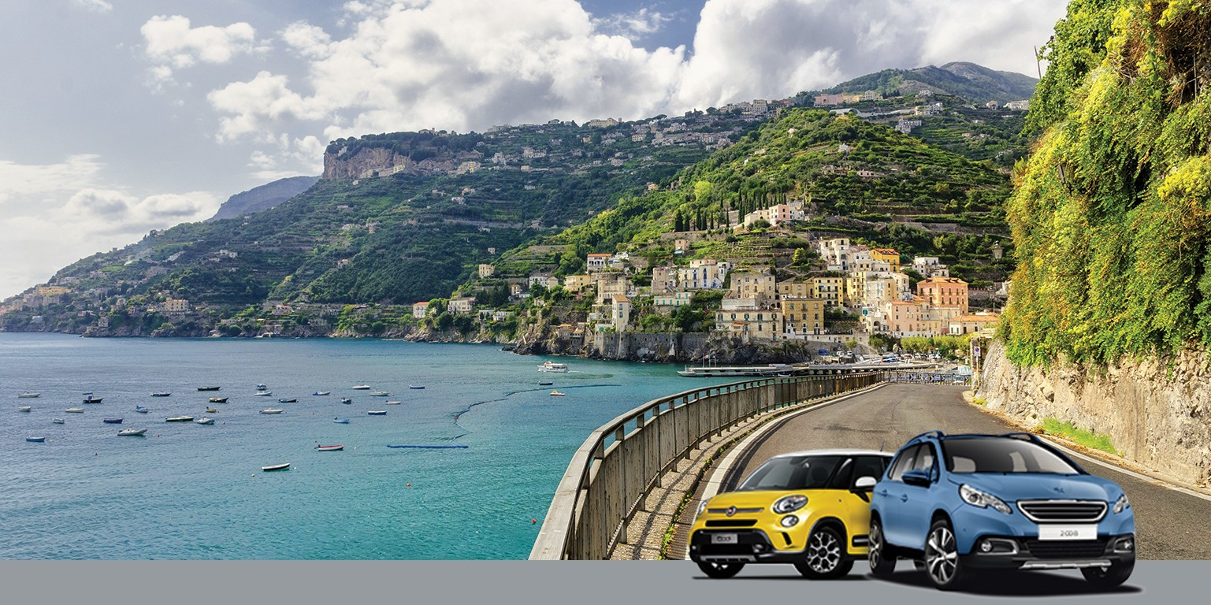
Welcome to our Car Rental Website

Slide 4
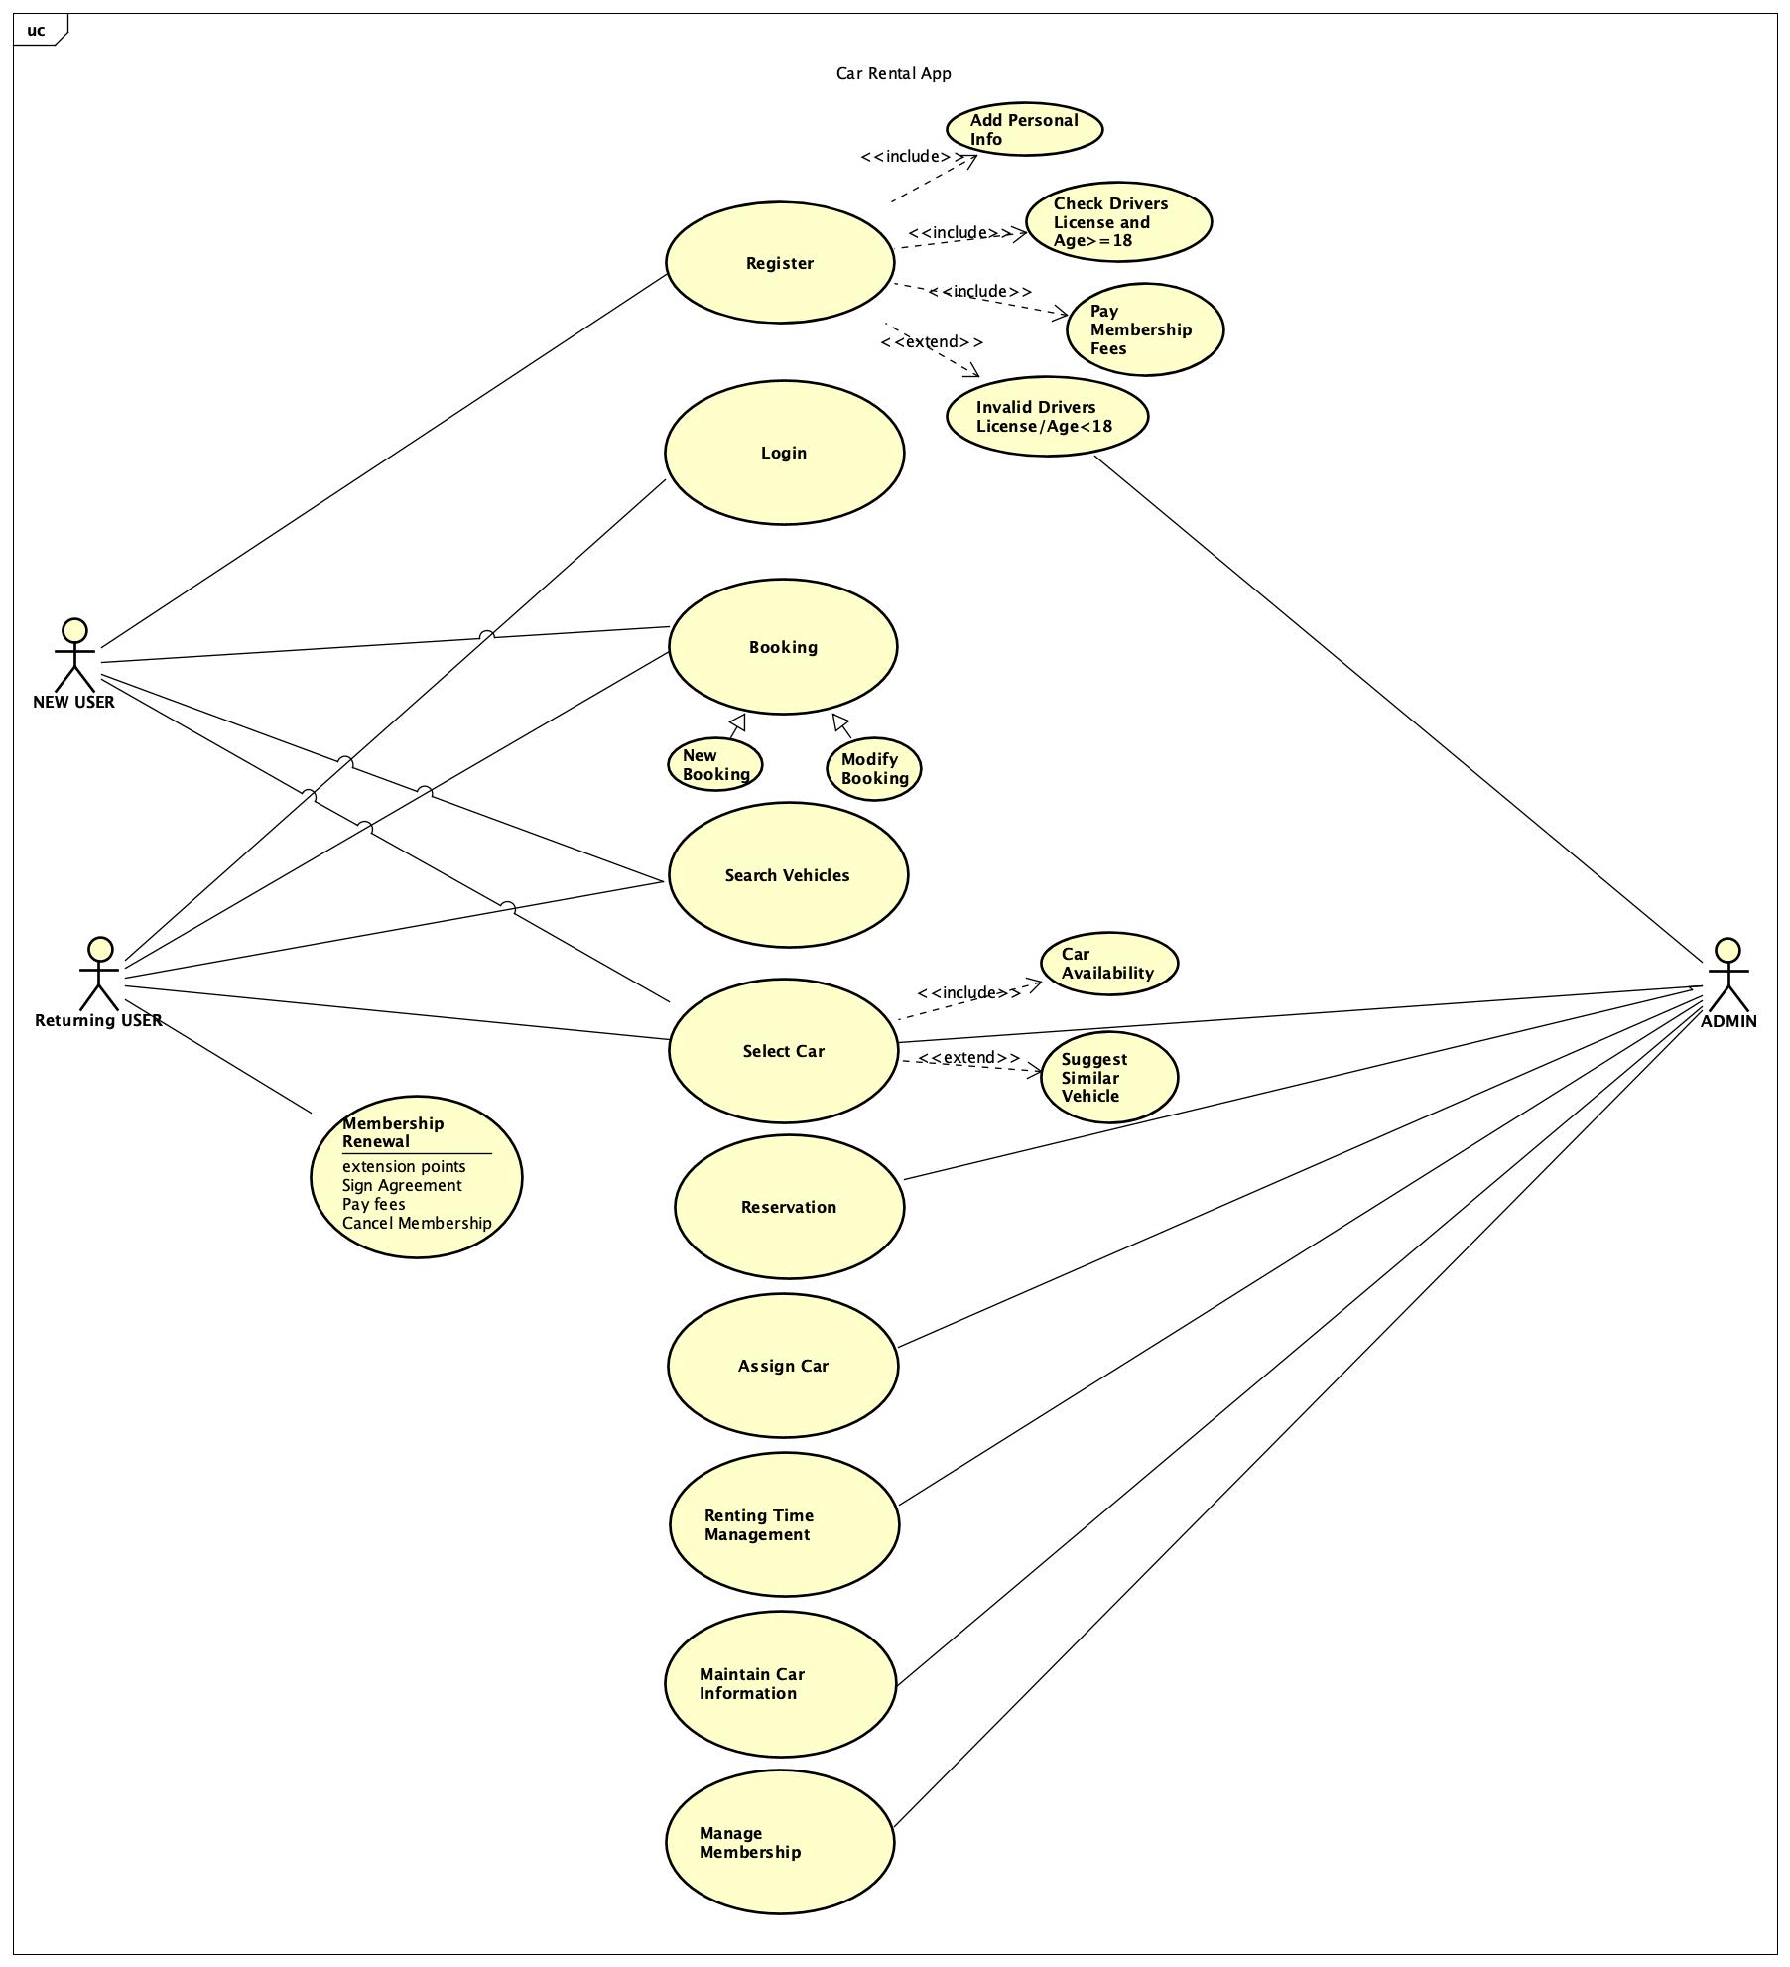
Use Case Diagram

Slide 5
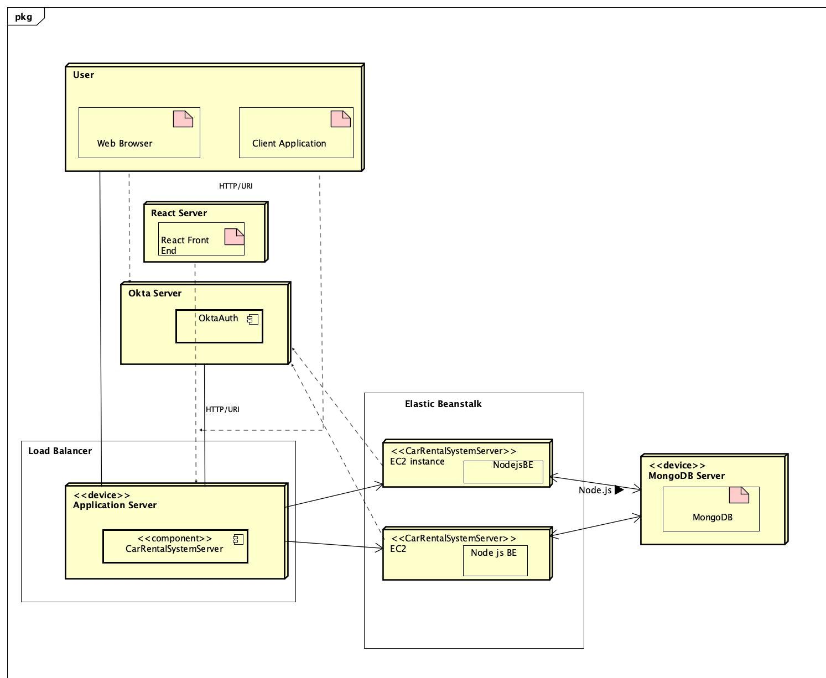
Deployment Diagram

Slide 6

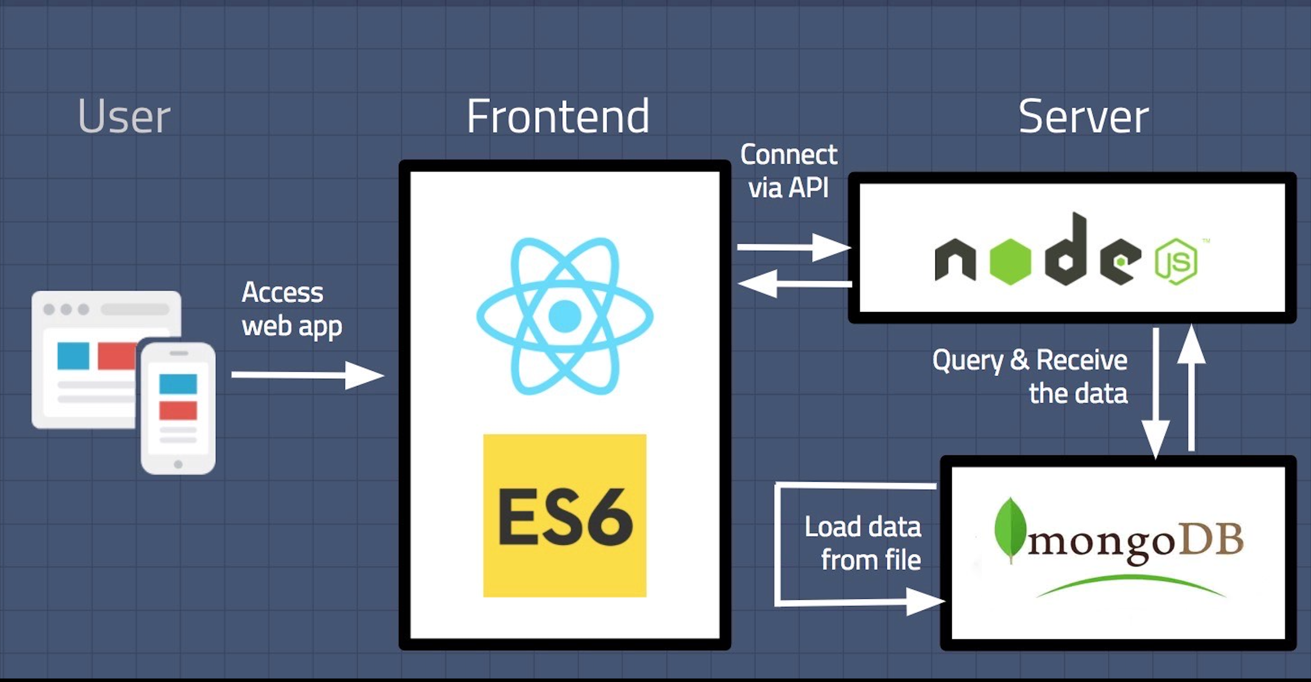
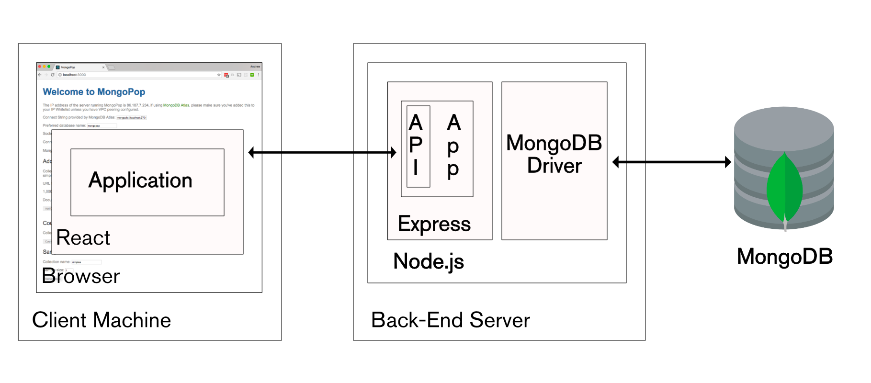
Architecture Diagram

Slide 7




Technical Stack

Slide 8
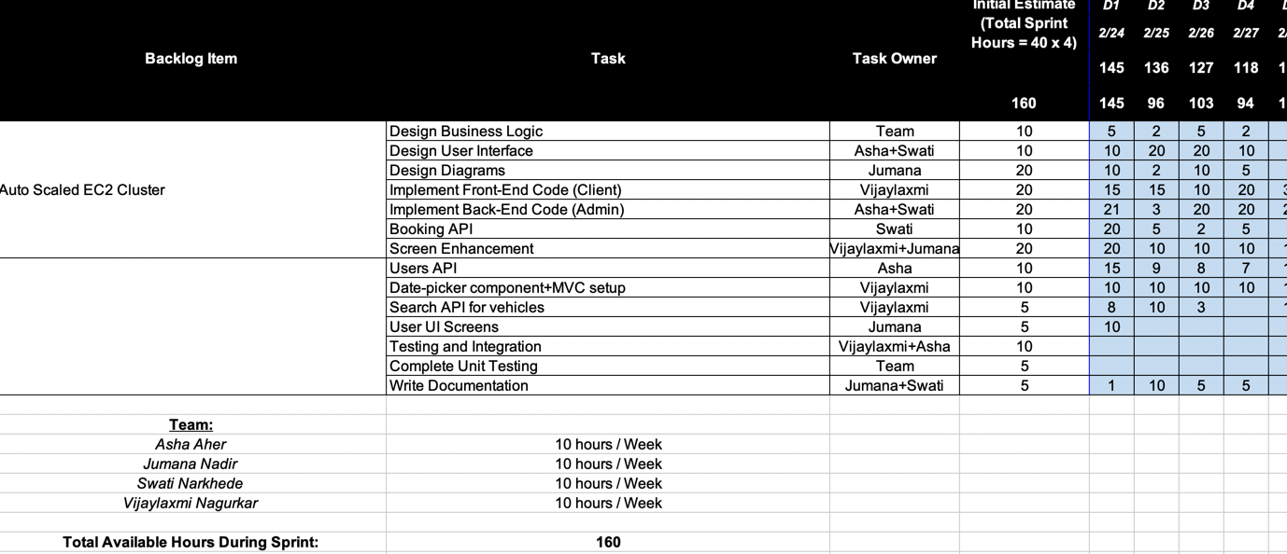
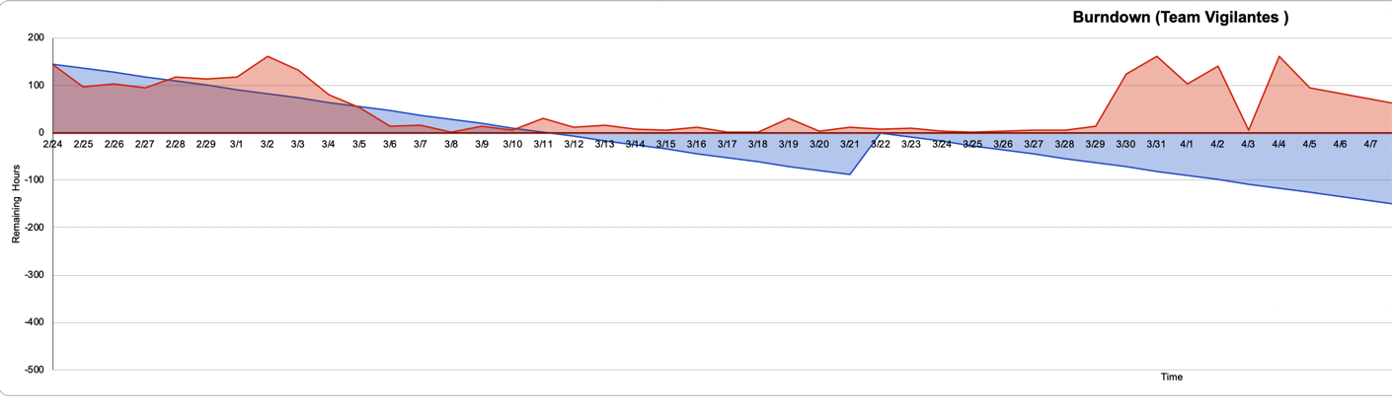
Our Sprint and Burndown Chart

Slide 9
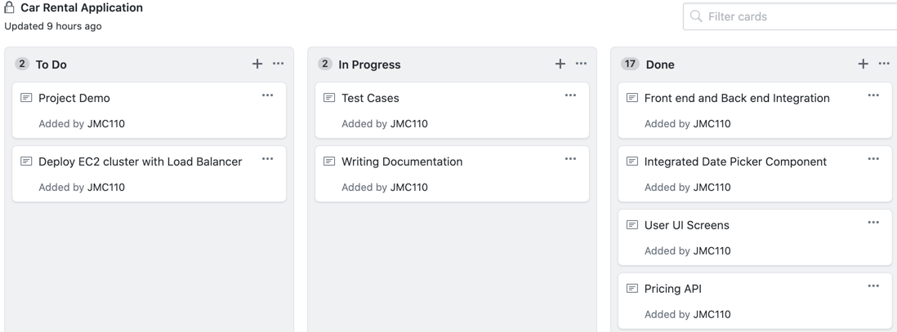
Project Board on GitHub

Slide 10
XP Core Values chosen- Communication
We are part of the team and we communicate daily.
We worked together from requirements to code.
We discussed and created the best solution to our problem that as a team.
We updated the progress of every sprint on zoom call and addressed blockers if any and discussed approach to mitigate the issue.

Slide 11
Design Pattern
MVC Design pattern:
We used MVC design pattern to design a solution for Car rental Application
MVC design pattern is distributed among three below parts.
Model : for Model we used MongoDB
View : for View we used React.js
Controller :for controller we used Node.js

